Slide 1
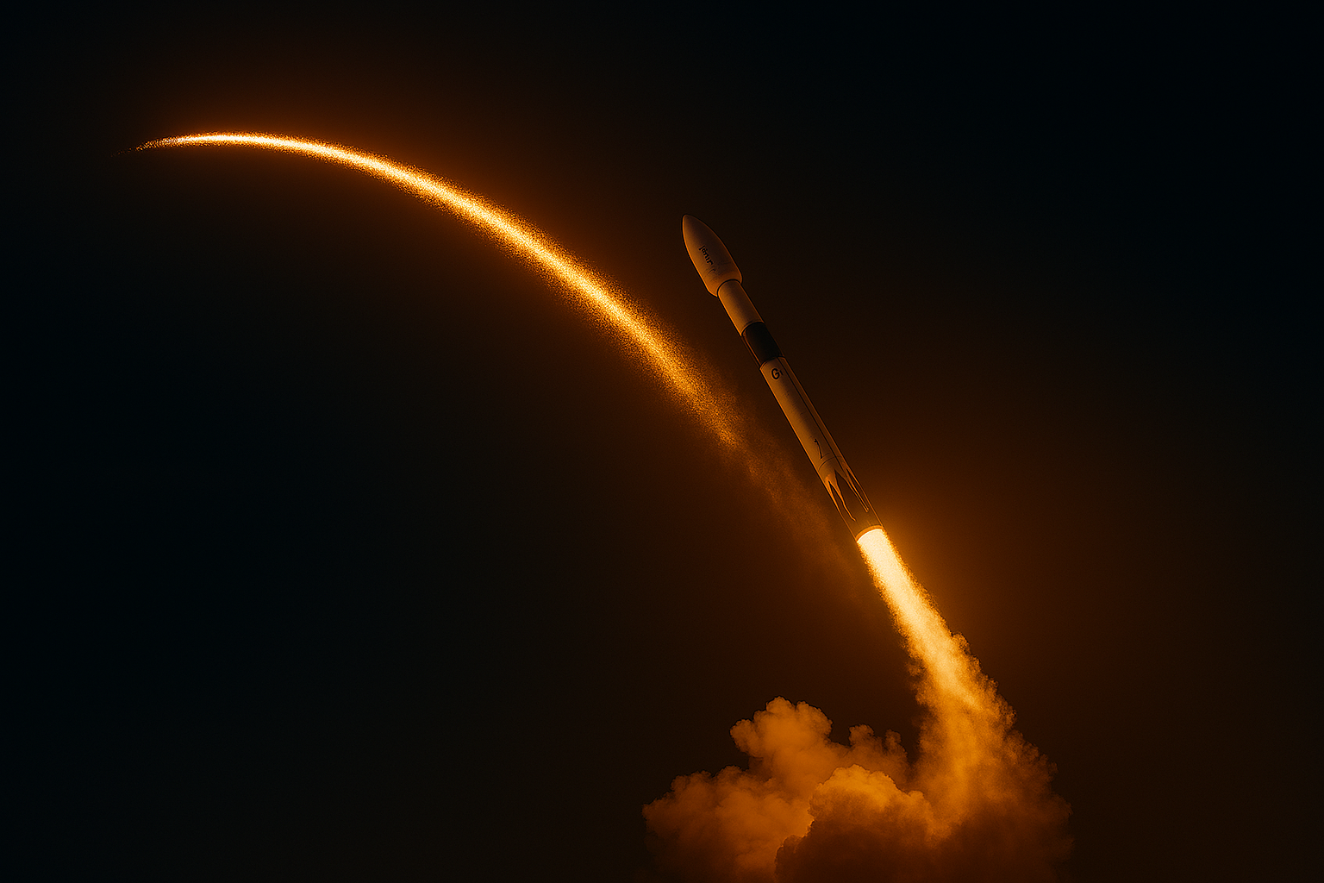
✨ Executive Summary
This project explores the predictive modeling of SpaceX Falcon 9 first-stage landing outcomes using historical launch data. With SpaceX’s emphasis on reusable rocket technology to reduce mission costs, accurately forecasting landing success is critical for operational planning and strategic decision-making.

Slide 2
Leveraging data from SpaceX’s API and Wikipedia launch records, the dataset was curated to include 90 launches with 18 relevant features such as payload mass, orbit type, booster version, and launch site. After thorough preprocessing—including feature engineering, encoding, and normalization—multiple machine learning models were trained and evaluated, including Logistic Regression, Decision Tree, Random Forest, and XGBoost.

Slide 3
The final model achieved over 90% accuracy, with strong precision and recall scores, particularly in predicting successful landings. Key insights revealed that booster reuse, orbit type, and launch site significantly influence landing outcomes. These findings were visualized through exploratory data analysis and integrated into a scalable predictive pipeline.

Slide 4
This project not only demonstrates the power of data science in aerospace applications but also lays the foundation for future enhancements such as real-time prediction dashboards, deeper feature integration, and broader mission coverage. The results support SpaceX’s mission to optimize launch reliability and cost-efficiency through data-driven insights.

